Slide 1
Construction, Analysis, Modification and Security of
128-EIA3
Peng Wang
SKLOIS, China
*

Slide 2
Outline
1) Introduction
2) Construction of 128-EIA3
3) Analysis of 128-EIA3
4) Modification of 128-EIA3
5) Security of 128-EIA3
*

Slide 3
1) Introduction
*

Slide 4

What is 128-EIA3?
128-EIA3 is a message authentication code based on stream cipher ZUC.
128-EIA3 has been adopted as the third integrity algorithm in the emerging 3GPP standard LTE.
M
H
ZUC
K
(IV,KEY)
R
T
Internatioanl Cryto Standard
Made in China
*

Slide 5
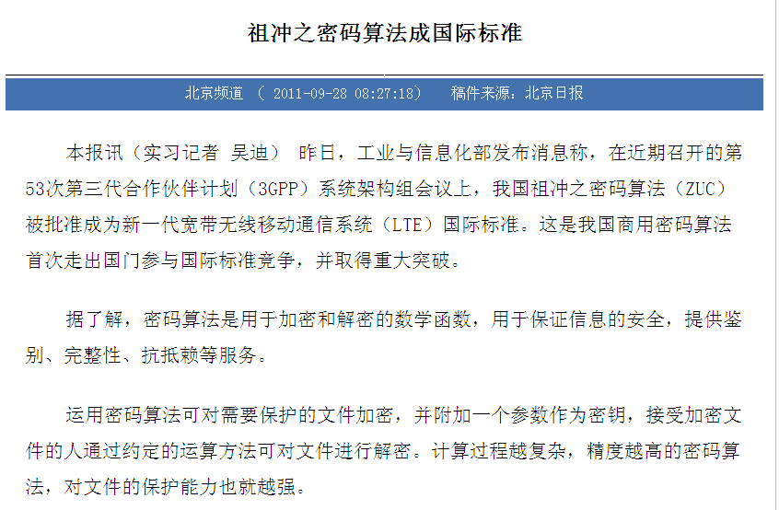
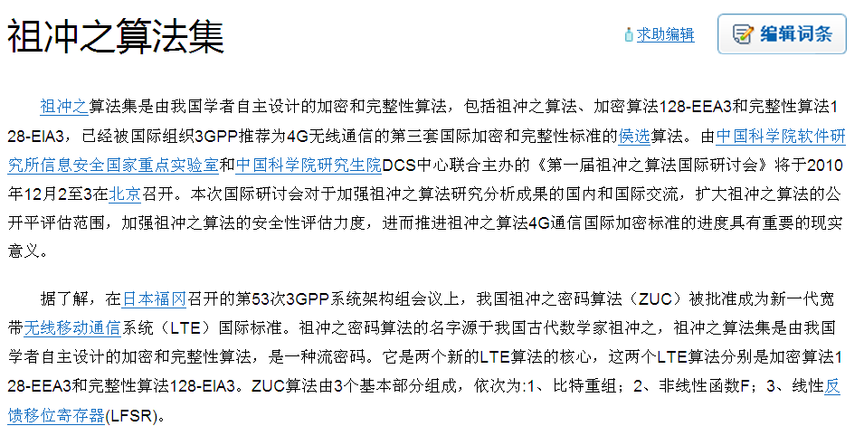
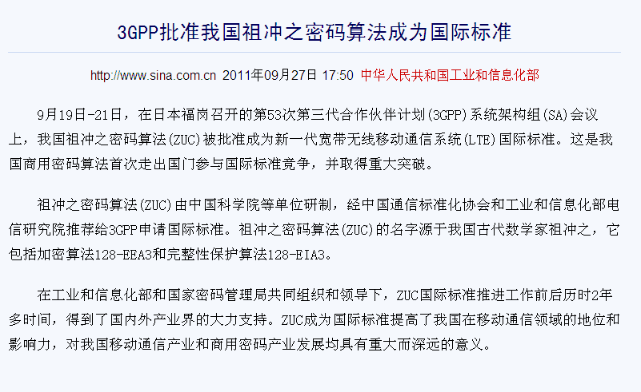
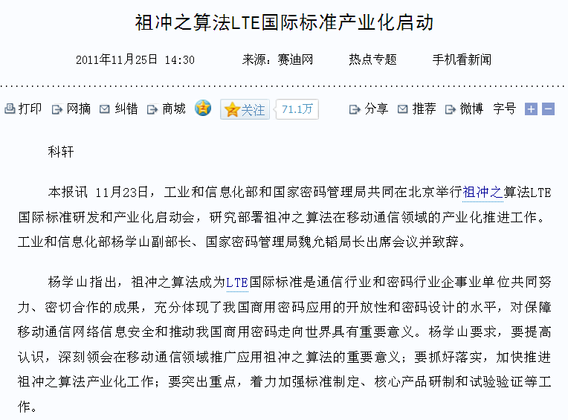
*

Slide 6
Standardization progress
EEA
EIA
ZUC
Expert team
contract
Paid expert team
evaluation
Public
evaluation
Algorithm acceptance
Go public
SAGE
evaluation
Agree and
sign NDA
May
Jun
Jul
Aug
Sep
Oct
Nov
Dec
Jan
Jun
Aug
Jan
…
Feb
Mar
Apr
May
Jul
Sep
Oct
Nov
Dec
Jun
…
Sep
Oct
Dec
2009
2010
2011
*
The First International Workshop on ZUC
The 2nd International Workshop on ZUC

Slide 7
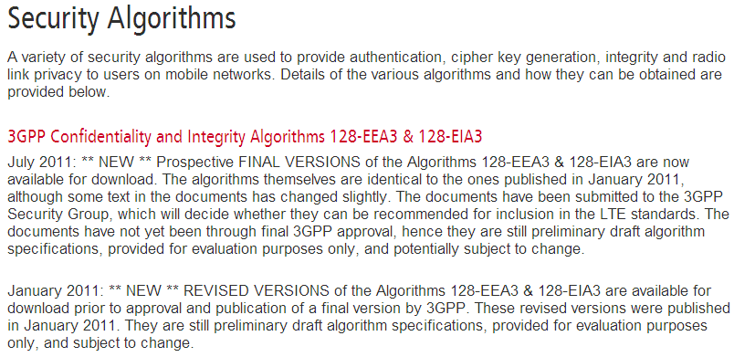
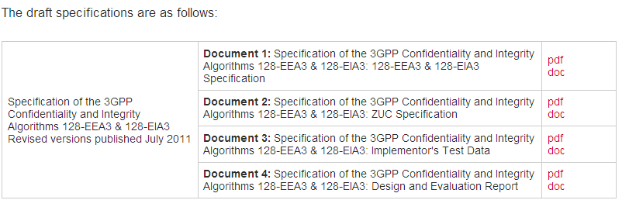
*

Slide 8

Message Authentication Code (MAC)
Data integrity protection
Data origin authentication
Message
(Message’, T’)
(Message, T)
Alice
Bob
Malice
T’ =MAC_{K} (Message’) ?
T = MAC_{K} (Message)
*

Slide 9
MACs based on Universal hash functions
Message
1) hash
2) mask
Universal hash function
K
One Time Pad
encryption
R_{i}
MAC
Wegman-Carter Scheme
*

Slide 10

Almost Xor Universal hash function [K94]
M
M’
H: K×D→R
H_{K}(M) = C
H_{K}
H_{K}
ε-AXU: Pr_{K∈K} [ H_{K} (M)⊕H_{K} (M’) = C] ≤ ε, ∀ M≠M’, C
*

Slide 11
Why hash-then-mask works?
If we know (M, T) H_{K}(M) ⊕ R = T
We try to forge (M’, T’) H_{K}(M’) ⊕ R = T’, M≠M’
H_{K}(M’) ⊕ R = T’
H_{K}(M) ⊕ H_{K}(M’) =T ⊕ T’
Prob. ≤ ε
*

Slide 12
Example of AXU functions (1)
H: {0,1}^{n}×{0,1}^{n}→{0,1}^{n}
H(K,M) = K· M
1/2^{n}-AXU
*

Slide 13
Examples of AXU functions (2)
Polynomial Evaluation Hash Function
H: {0,1}^{n}×{0,1}^{nm}→{0,1}^{n}
H(K,M)= f(K)
f(x) = M₁x^{m}+M₂x^{m-1}+ … +M_{m}x
m/2^{n}-AXU
*

Slide 14
Universal hashing MAC
Rogaway : Bucket hashing (1995)
Halevi-Krawczyk : MMH (1997)
Black-Halevi-Krawczyk-Krovertz-Rogaway : UMAC (1999)
Bernstein: Poly1305(2005)
……
*

Slide 15
2) Construction of 128-EIA3
*

Slide 16
Toeplitz matrix based AXU function [K95]
|Output|=4, |Message|=6
b₀ b₁ b₂ b₃ b₄ b₅ b₆ b₇ b₈
Keystream：
1 0 1 0 0 1
Message：
m_{o} m₁ m₂ m₃ m₄ m₅
Output：
h
← h⊕
*

Slide 17
in matrix form
m_{o}
m₁
m₂
m₃
m₄
m₅
b₀ | b₁ | b₂ | b₃ | b₄ | b₅
b₁ | b₂ | b₃ | b₄ | b₅ | b₆
b₂ | b₃ | b₄ | b₅ | b₆ | b₇
b₃ | b₄ | b₅ | b₆ | b₇ | b₈
.
Toeplitz matrix
*

Slide 18
or
b₀
b₁
b₂
b₃
b₄
b₅
b₆
b₇
b₈
m₀ | m₁ | m₂ | m₃ | m₄ | m₅ | 0 | 0 | 0
0 | m₀ | m₁ | m₂ | m₃ | m₄ | m₅ | 0 | 0
0 | 0 | m₀ | m₁ | m₂ | m₃ | m₄ | m₅ | 0
0 | 0 | 0 | m₀ | m₁ | m₂ | m₃ | m₄ | m₅
.
*

Slide 19
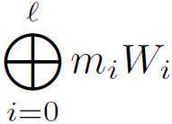
Generally
For a l-bit message M= (m₀,m₁, …, m_{l-1})
We need (l+n-1)-bit keystream:
K = b₀, b₁, b₂, … … , b_{l+n-2}
W_{i}
l-1
H’_{K}(M) =
H is 1/2^{n}-AXU
*

Slide 20
But
The above result only holds for fixed-length messages.
How to treat variable-length messages？
*

Slide 21
We notice that
H’_{K}(M)=H’_{K}(M0…0)
For different-length messages M and M’, |M|<|M’|
we can pad M with 0s，s.t.
|M0…0|=|M’|
but we want differences after padding
*

Slide 22
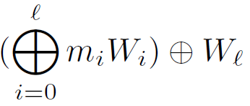
How？
We only need pad 1 after M.
M → M 1
l-1
H’_{K}(M) =
l-1
H_{K}(M) = H’_{K}(M1) =
*

Slide 23
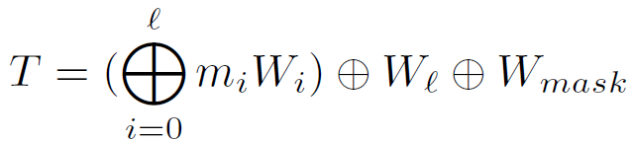
128-EIA3 v1.4
b₀,b₁, …b₃₁, …,b_{l+31}, … , b_{l+31}, b_{l+32} …… ,b_{l+63}
Unfortunately, choose the mask value the wrong way
*

Slide 24
128-EIA3
M
H
ZUC
K
(IV,KEY)
R
T
128-EIA3(IV, KEY, M) = H(K,M) ⊕ R
*

Slide 25

128-EIA3 v1.4
ZUC(IV,KEY)
b₀,b₁, …b₃₁, …,b_{l+31}, … , b_{l+31}, b_{l+32} …… ,b_{l+63}
W₀
W₁
W_{l-1}
W_{l}
W_{mask}
T = H(K, M) ⊕ R
*

Slide 26
3) Analysis of 128-EIA3
T. Fuhr, H. Gilbert, J. Reinhard, and M. Videau. Analysis of the initial and modified version of the candidate 3GPP integrity algorithm 128-EIA3. SAC 2011.
*

Slide 27
Introduction to 128-EIA3
IV-dependent MAC
  1) a 128-bit key
  2) 128-bit initial vector
  3) a 1-20000 bits message
  4) 32-bit MAC value
Security Goal: Unforgeability
Infeasible to generate a new valid (IV, Message, MAC)
Message
128-EIA3(IK, IV)
MAC
*

Slide 28
b₀,b₁, …b₃₁, …,b_{l+31}, … , b_{l+31}, b_{l+32} …… ,b_{l+63}
W₀
W₁
W_{l-1}
W_{l}
W_{mask}
*

Slide 29

Some observations
W_{i} s are not independent
W_{mask}s are also related for the same IV
*

Slide 30

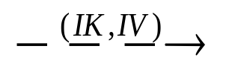




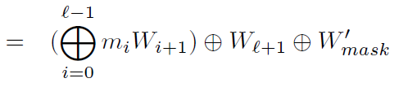

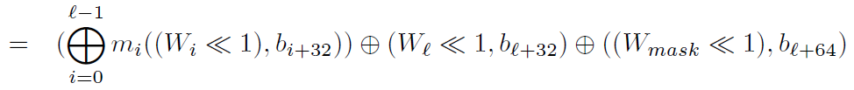

For two different messages and the same IV…
*

Slide 31
An Existential Forgery
When we get (IV, M, T)
M = (m₀,…,m_{l-1})
We forge (IV, M’, T’)
M’ = (0,m₀,…,m_{l-1})
T’ = (T<<1, β)
The success probability is 1/2.
*

Slide 32

Modification: A slight variant of 128-EIA3
b₀,b₁, …b₃₁, b₃₁…,b_{l+31}, … , b_{l+31}, b_{l+32} …… ,b_{l+63}
W_{mask}
W₀
W₁
W_{l-1}
W_{l}
*

Slide 33
Conclusion
128-EIA3 v1.4 does not offer an adequate security.
The identified weakness does neither relate to the core of 128-EIA3 v1.4,
nor to the underlying stream cipher ZUC,
But only to the way the mask values are derived from the keystream.
*

Slide 34
4) Modification of 128-EIA3
*

Slide 35
How to make modification？
Big change？
  New design
Small tweak？
  How to mask
*

Slide 36

Tweak 1
Mask with first word [FGRV11]
ZUC(IV,KEY)
Z[1]
Z[2]
Z[L-1]
Z[L]
……
T = H(K, M) ⊕ R
*

Slide 37

Tweak 2
Mask with last word
ZUC(IV,KEY)
Z[1]
Z[2]
……
Z[L-1]
Z[L]
T = H(K, M) ⊕ R
*

Slide 38
Comparison
Tweak 1: Bigger change to the previous scheme,
but no change to the proof.
Tweak 2: Smaller change to the previous scheme,
but more complicated proof.
*

Slide 39
5) Security of 128-EIA3
*

Slide 40
128-EIA3
M
H
ZUC
K
(IV,KEY)
R
T
*

Slide 41
T= H(K,M) ⊕ Z[L]
ZUC(IV,KEY)
Z[1]
Z[2]
……
Z[L-1]
Z[L]
T = H(K, M) ⊕Z[L]
*

Slide 42
Assumption：random key stream generated by ZUC
ZUC(IV₁,KEY) → k₁₁k₁₂k₁₃……
ZUC(IV₂,KEY) → k₂₁k₂₂k₂₃……
……
Random key stream
ZUC(IV_{m},KEY) → k_{m1}k_{m2}k_{m3}……
IVs are not repeating
*

Slide 43
128-EIA3
(IV, M,T)
Receiver
Sender
M
1 (accept)
0 (reject)
T= 128-EIA3(IV,KEY,M)
*

Slide 44
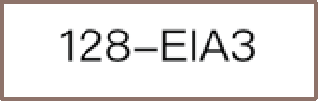

Security model
Unforgeability
…
(IV, M,T)
T= 128-EIA3(IV,KEY,M)
*

Slide 45
Properties of the function H
1) H(K, M) is 1/2^32 AXU
  For x, x‘∈D, x≠x’ and y∈R, Pr[H(k,x)⊕H(k,x')=y]≤ 1/2^32
2) H(K, M) is uniform
  For any x∈D and y∈R, Pr[H(k,x) =y]=1/2^32
*

Slide 46

Security proof of 128-EIA3 v1.5
(IV₁,M₁,T₁)
(IV₂,M₂,T₂)
……
IVs are different
Adversary
(IV_{s},M_{s},T_{s})
Output: (IV, M, T)
*

Slide 47
If IV is new,
then H(K,M) ⊕ Z[L] is random to the adversary
p=2⁻³²
Suppose: IV = IV₁
*

Slide 48

IV=IV₁
ZUC(IV₁,KEY)
Z[1]
Z[2]
……
Z[L₁-1]
Z[L₁]
T₁ = H(K₁, M₁) ⊕ Z[L₁]
*

Slide 49
The success probability is:
Under the condition of known (IV₁,M₁,T₁), the probability of the valid (IV, M, T):
ZUC(IV,KEY)
p=Pr[T = H(K, M) ⊕ Z[L]|T₁ = H(K₁, M₁) ⊕ Z[L₁]]
Try to forge
Known
*

Slide 50
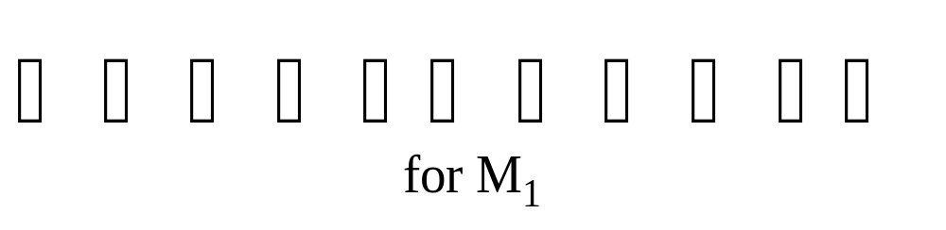
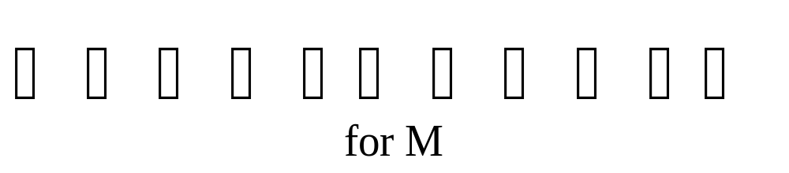
1） L>L₁
ZUC(IV,KEY)
Z[1]
Z[2]
……
Z[L₁-1]
Z[L₁]
Z[L]
……
p=2⁻³²
*

Slide 51
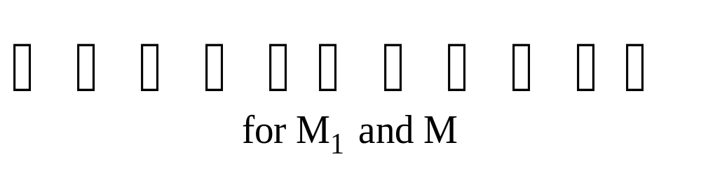
2） L=L₁
ZUC(IV,KEY)
Z[1]
Z[2]
……
Z[L-1]
Z[L]
p=Pr[T = H(K, M) ⊕ Z[L]|T₁ = H(K₁, M₁) ⊕ Z[L]]
=Pr[H(K, M) ⊕ H(K₁, M₁) =T ⊕ T₁
|T₁ = H(K₁, M₁) ⊕ Z[L]]
=Pr[H(K, M) ⊕ H(K₁, M₁) =T ⊕ T₁ ]=2⁻³²
*

Slide 52


3） L<L₁
ZUC(IV,KEY)
Z[1]
Z[2]
……
Z[L-1]
Z[L]
Z[L₁]
……
*

Slide 53
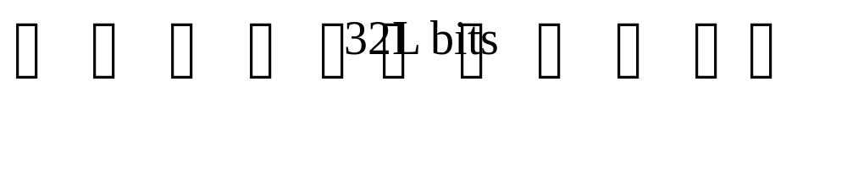
ZUC(IV,KEY)
Z[1]
Z[2]
……
Z[L-1]
Z[L]
Z[L₁]
……
H(K, M) ⊕Z[L]
= H(K’, M||1||0^{s})
……
Z[1]
Z[2]
……
Z[L-1]
Z[L]
Z[L₁]
*

Slide 54
p=Pr[T = H(K, M) ⊕ Z[L]|T₁ = H(K₁, M₁) ⊕ Z[L₁]]
=Pr[T=H(K’, M||1||0^{s})|T₁ = H(K₁, M₁) ⊕ Z[L₁]]
=Pr[T=H(K’, M||1||0^{s}] =2⁻³²
*

Slide 55
Comments on 128-IEA3 V1.5
128-IEA3 v1.5 is still not a generic Wegman-Carter Scheme.
Security of 128-EIA3 v1.5 is based on AXU and uniformity of the underlying universal hash function,
or uniformity solely, because uniformity implies AXU in 128-EIA3 v1.5 .
*

Slide 56
Question at ZUC forum. http://zucalg.forumotion.net/
Why not AES?
Why not eStream?
“Chinese algorithm” means China can break it?
Is there something wrong with the other LTE algorithms?
What happens now to the other LTE algorithms?
Why does China get this special privilege?
If every other country insists on a home-grown algorithm, will every LTE phone have to support 200 algorithms?
Authenticated encryption?
*

Slide 57
References
[WC81] Wegman and Carter, New hash functions and their use in authentication and set equality. 1981.
[K94] Krawczyk. LFSR-based hashing and authentication. Crypto’94. Springer-Verlag, 1994, LNCS 839, 313-328.
[K95] Krawczyk. New hash functions for message authentication. Crypto’95. Springer-Verlag, 1995, LNCS, 129-139.
[S96] Shoup. On Fast and Provably Secure Message Authentication Based on Universal Hashing Advances in Cryptology -- CRYPTO 1996, Springer-Verlag, 1996, LNCS 1109, 313-328.
[FGRV10] T. Fuhr, H. Gilbert, J. Reinhard, and M. Videau. A Forgery Attack on the Candidate LTE Integrity Algorithm 128-EIA3
[FGRV11] T. Fuhr, H. Gilbert, J. Reinhard, and M. Videau. Analysis of the Initial and Modified Versions of the Candidate 3GPP Integrity Algorithm 128-EIA3
*

Slide 58
Thanks
Questions?
wpeng@iie.ac.cn
*

